Slide 2
3 Easy ways to reduce your R-squared without any exercise!
Predicting Nba salaries from individual player statistics

Slide 3

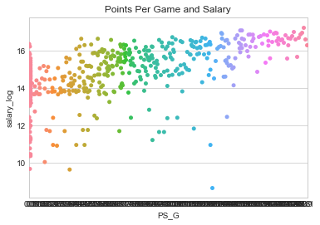

Slide 4
Our model: OLS Linear regression to predict salaries
Minutes played
1
Points per game
2
Free throw percentage
3
Age
4
Games Started
5

Slide 5
Log of Salary
R- squared .355
Adjusted R-squared : .349

Slide 6
What do I do now?

Slide 7
First Easy way to improve r Squared: BoxCox on response And reduce Features

Slide 8
SEcond Easy Way! ADD More features
Age, Games, Games Started, Minutes Played, Field Goals Turnovers, Blocks, Points, Free Throws…etc.
26 Features in all.

Slide 9

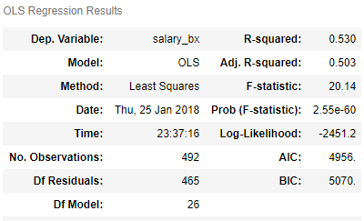
R squared
Increase of 18 percentage points when combined with box cox.

Slide 10
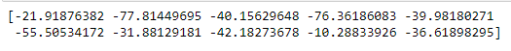
Cross validation & R-squared

Slide 11
What went wrong?

Slide 12
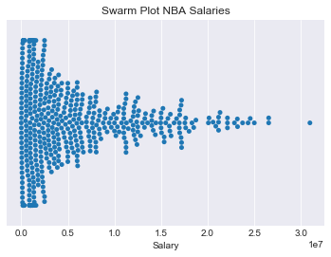

Slide 13
Step 3 for increasing R Squared.
Cut outliers: Salaries only above $500k and top 20 players

Slide 14


Slide 15
Ways to improve
Although R-sq went to .63 Can we trust it?
Get more data.
More sophisticated modeling.
Better feature selection.
Deploy times series on multiple years of data.

Slide 16
Ways to improve R - squared
Box Cox and Reduce Marginal Features
Add More Features
Cut outliers

